Slide 1


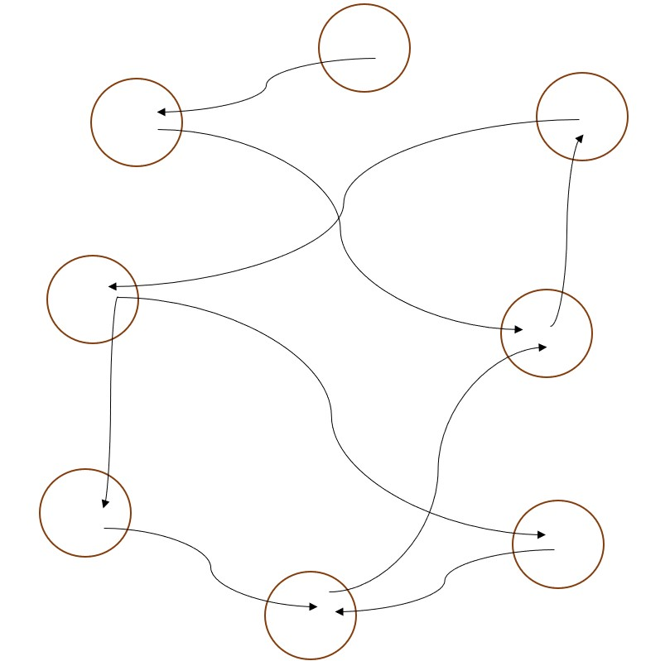
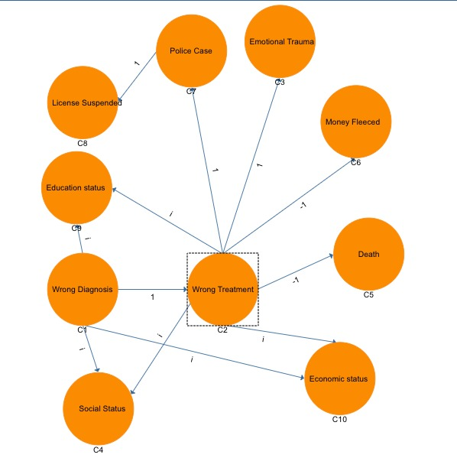
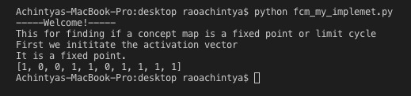
Medical Treatment Negligence Analysis
Problem Statement
Graphical Abstract
To analyse the causes of medical negligence, which ultimately results in loss of life of people at times, by studying multiple real-life cases and obtaining inference from the same using mathematical model.
Objectives
Develop a cognitive model for analysis of the issues where negligence of doctors and hospitals has caused great distress to the affected families and people
Extract insights from the collected news reports of various cases related to negligence of doctors/hospital authorities
Minimise the numerous deaths/mishaps of innocent people
Model & Methodology
Experimental Setup & Results
.
.
Cognitive map with weights, showing relationship between different attributes of an example case.
Software:
JetBrain PyCharm Community
Yed Editor
Conclusions Team
1. We inferred that medical negligence is not only caused due to the negligence of the doctors; rather it involves several other parameters like education status, bribery, hate, etc.
2. Hospital environment conditions are one of the primary causes of mishaps.
3. Strong correlation exists between economy status and the mishaps happening due to negligence.
Abinash Satapathy
Configuration
Achintya S Rao
Arunim Roy

